Slide 1

MACHINE
INTELLIGENCE
Maximum Likelihood
and Bayes Optimal Classifier
K.S.Srinivas
Department of Computer Science and Engineering

Slide 2
MACHINE
INTELLIGENCE
Maximum Likelihood
and Bayes Optimal Classifier
K.S.Srinivas
Department of Computer Science and Engineering

Slide 3

MACHINE INTELLIGENCE
Maximum Likelihood and Bayes Optimal Classifier
K.S.Srinivas
Department of Computer Science and Engineering

Slide 4
MACHINE INTELLIGENCE
Maximum Likelihood and Least Squared Error Hypothesis
Let us consider a continuous valued target function.
Probably one of the problem faced by many learning approaches such as Neural network,Linear Regression,Polynomial Curve fitting
A straight forward Bayesian analysis will show that under certain assumption
any learning algorithm that minimizes output hypothesis prediction and the training data will output maximum likelihood hypothesis (H_{ML})
we have already witnessed this???
In neural network method the attempt to minimize the sum of the squared error over the training data

Slide 5
MACHINE INTELLIGENCE
Maximum Likelihood and Least Squared Error Hypothesis
Learner L : X--->R ,where R represents a set of real number.
L to learn unknown target function f: X-->R drawn from H
number of training examples be m
We will assume our training data t be noisy
So,each instance has training examples <x_{i},d_{i}>,where d_{i} is noisy training value such that d_{i}=f(x_{i})+e_{i,}where e_{i} is a random variable noise that is drawn from a Gaussian Distribution with mean 0.
function f
target function
f (H_{ML})

Slide 6
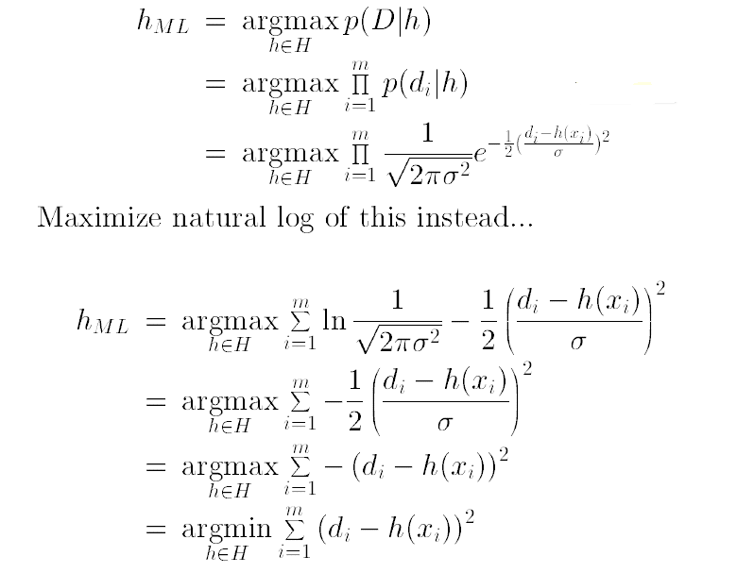
MACHINE INTELLIGENCE
Maximum Likelihood and Least Squared Error Hypothesis
Let us assume all hypothesis start with equal probability.
Now,
where p is probability distribution
Given noise e_{i} obeys Normal Distribution,then d_{i} obeys Gaussian Distribution
According to Gaussian Distribution
where μ=h(xi)

Slide 7














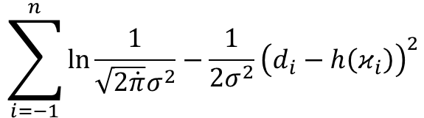


MACHINE INTELLIGENCE
Maximum Likelihood and Least Squared Error Hypothesis
we now apply a transformation i.e common in max likelihood calculations
Rather than maximizing this as complicated expression we shall choose to maximize its (loss complicated) logarithm.
The first term in this expression is a constant ,independent of ln and can therefore be discarded yielding.
$$\sum_{i=−1}^{n}{\ln{\frac{1}{\sqrt{2\dot{π}}σ^{2}}}}−\frac{1}{2σ^{2}}{\left(ⅆ_{i}−h\left(κ_{i}\right)\right)}^{2}$$

Slide 8
MACHINE INTELLIGENCE
Maximum Likelihood and Least Squared Error Hypothesis
maximizing those negative quantity is same as minimizing the positive quantity ,yielding us
finally we can discard the constants ,independent og h ,giving us
We can also easily prove that the Maximum Likelihood hypothesis while predicting probabilities will be the same as minimizing the cross entropy loss.

Slide 9
MACHINE INTELLIGENCE
Maximum Likelihood and Bayes Optimal Classifier
K.S.Srinivas
Department of Computer Science and Engineering

Slide 10
MACHINE INTELLIGENCE
Bayes Optimal Classifier
We have so far covered – “What is the most probable hypothesis given the training data?”.
But we can now attempt to answer the question, “What is the most probable classification of a new instance given the training data?”
We can answer this by using MAPhypothesis to new instance,but we can do better
Consider a hypothesis space consisting of 3 hypothesis h₁,h₂,h₃.
Suppose positive probability of these hypothesis given the training data are 0.4,0.3 and 0.3 respectively.
Suppose a new instance x is encountered ,which is classified as +ve by h₁ and -ve by h₂ and h₃.
Taking all hypothesis into account ,the probability that x is positive is 0.4 and probability that x being negative is 0.6
The most probable classification is -ve.
In this case it is different from the classification generated by MAP hypothesis

Slide 11
MACHINE INTELLIGENCE
Bayes Optimal Classifier
In general the most probable classification of new instance is obtained by combined the prediction of all hypothesis ,weighted by their posterior probabilities.
If the possible classification of the new instance can take one of any value V_{j} from set V, then the probability P(V_{j}|D) that the correct classification for the new instance is V_{j} is
where P(h_{i}|D) is the weight associated with hypothesis h_{i}
The optimal classification of the new instance is the value V_{j},for which P(V_{j}|D) is maximum i.e

Slide 12
MACHINE INTELLIGENCE
Bayes Optimal Classifier
To illustrate in terms of the above example ,the set of possible values of new instance is V
and h1 ,h2 and h3 are three hypothesis
Therefore,
V | +ve | -ve
THIS EQUATION IS CALLED Bayes Optimal Classifier
or
Bayes Optimal Learner
P(h₁|D) | 0.4
P(h₂|D) | 0.3
P(h₃|D) | 0.3
P(-ve|h₁) | 0
P(-ve|h₂) | 1
P(-ve|h₃) | 1
P(+ve|h₁) | 1
P(+ve|h₂) | 0
P(+ve|h₃) | 0

Slide 13
MACHINE INTELLIGENCE
Bayes Optimal Classifier
This method maximizes the probability that new instance is classified correctly,given the available data,hypothesis space and prior probabilities over the hypothesis.

Slide 14
MACHINE INTELLIGENCE
Gibbs Algorithm
Bayes optimal Classifier obtains the best performance that can be achieved from the training data,it is quite costly to apply.
The expense is due to the fact that it computes the posterior probability for every hypothesis in H and combines the prediction of each hypothesis to classify new instance
An alternative less optimal method is the “GIBBS ALGORITHM” defined as follows
Choose a hypothesis h from H at random according to posterior probability distribution of over H.
use 'h' to predict the classification of the next instance x
Note: surprisingly, it can be shown that under certain conditions the expected misclassification error for GIBBS ALGORITHM is at most twice the expected error of Bayes Optimal Classifier

Slide 15
THANK YOU
K.S.Srinivas
srinivasks@pes.edu
+91 80 2672 1983 Extn 701

Slide 16
MACHINE
INTELLIGENCE
Naïve Bayes and Applications
K.S.Srinivas
Department of Computer Science and Engineering

Slide 17
MACHINE INTELLIGENCE
Naïve Bayes and Applications
K.S.Srinivas
Department of Computer Science and Engineering

Slide 18
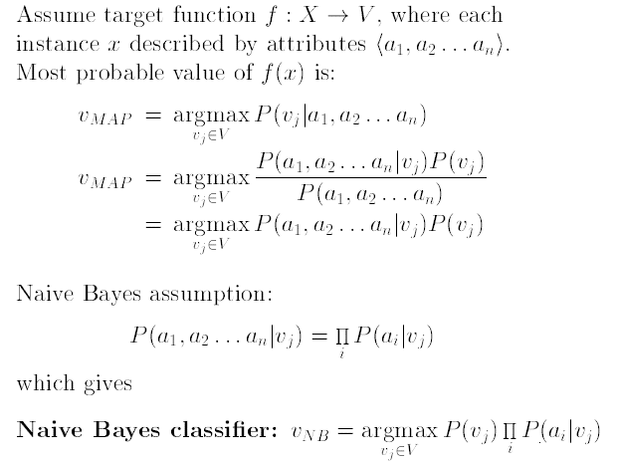
MACHINE INTELLIGENCE
Naive Bayes Classifier
Highly practical Bayesian Learning method
Comparable performance with neural network and decision tree learning.
Naive Bayes classier applies to learning task where each instance x is classified by the conjunction of attribute value and where the target function f(x) can take any value from finite set V.
A set of training examples of the target function is provided,and a new instance is presented in tuple of (a1,a2,a3,a4,........an)
The learner/classifier is asked to predict the target value or the classification of the new instance.
The Bayesian approach to classify the new instance is to assign the most probable value.
V_{MAP} given attribute values(a1.....an) that describe the instance is

Slide 19
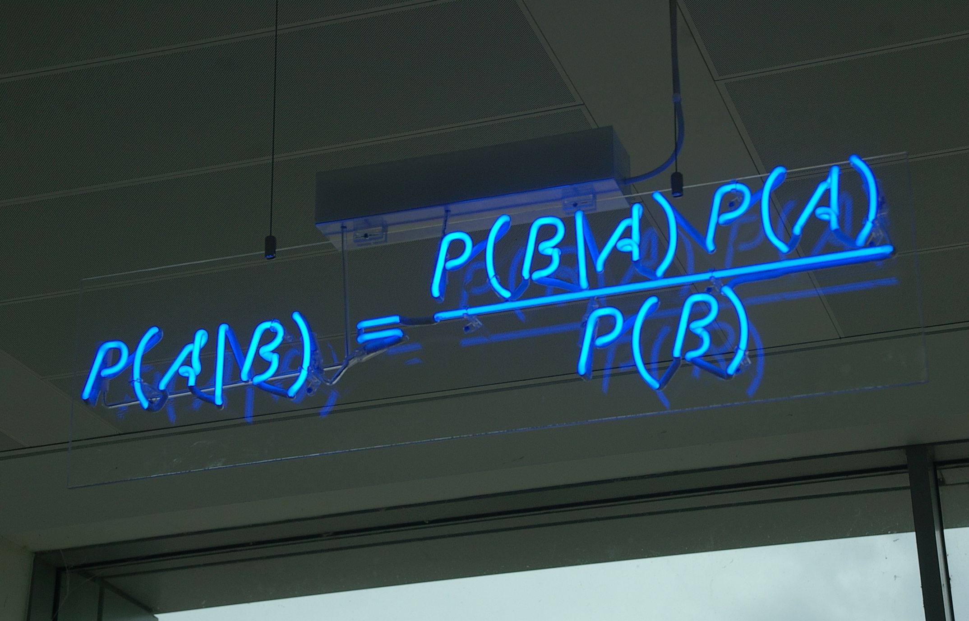
MACHINE INTELLIGENCE
Naive Bayes Classifier
Lets recall Bayes theorem
using this
It is easy to count P(V_{j}):
Count of the no of frequency with target value V_{j}.Occurring in the training set.
Looks easy to you until ,we think what if the training data set is very very large

Slide 20
MACHINE INTELLIGENCE
Naive Bayes Classifier
Naive Bayes Classifier is based on simplifying assumption that the attribute values are conditionally independent given the target value
i.e the assumption is that given the target value of the instance,the probability of observing the conjunction a1,a2,a3,.....an is just the product of the probabilities for the individual attributes
using this in our V_{MAP} equation

Slide 21
MACHINE INTELLIGENCE
Naive Bayes Classifier
Lets note few things
Number of distinct P(a_{i}|V_{j}) terms that must be estimated from the training set:'D' is equal to the number of distinct attribute value times the number of distinct target values
Based on the frequencies over the training set
whenever NB assumption of conditional independence is satisfied,this NB classification=MAP classification

Slide 22
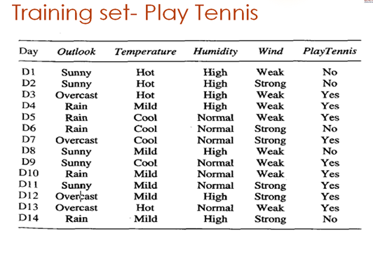
MACHINE INTELLIGENCE
Example- Play Tennis
Recall the data set that we used to build a Decision Tree
with 14 samples of target concept Play Tennis with values YES or NO
Each day is described by attributes, (OUTLOOK,TEMPERATURE,HUMIDITY,WIND)
use NB classifier and the training data from the table to classify the following novel instance.
x=(Outlook=Sunny, Temp=Cool, Hum=High, Wind=strong)

Slide 23
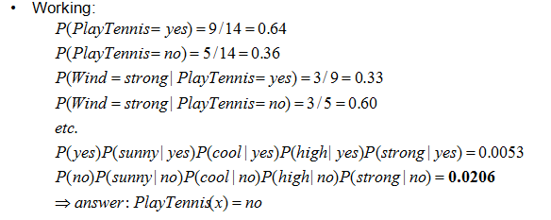
MACHINE INTELLIGENCE
Example- Play Tennis
=argmax[
P(V_{j}).P(outlook=sunny|v_{j}).P(temperature=cool|v_{j}).P(humidity=high|v_{j}).P(wind=strong|v_{j}). ]
V_{j} can be YES or NO
probabilities of the different target values can easily be estimated based on their frequency over the 14 training examples

Slide 24
MACHINE INTELLIGENCE
Example- Play Tennis
similarly we estimate the conditional probabilities
P(wind=strong|play tennis=YES)=3/9=0.33
P(wind=strong|play tennis=NO)=3/5=0.60
P(outlook=sunny|play tennis=YES)=2/9=0.2222
P(outlook=sunny|play tennis=NO)=3/5=0.60
P(Temp=cool|play tennis=YES)=3/9=0.333
P(Temp=cool|play tennis=NO)=1/5=0.2
P(humidity=high|play tennis=YES)=3/9=0.333
P(humidity=high|play tennis=NO)=4/5=0.80

Slide 25
MACHINE INTELLIGENCE
Example- Play Tennis
P(wind=strong|play tennis=YES)=3/9=0.33
P(wind=strong|play tennis=NO)=3/5=0.60
P(Temp=cool|play tennis=YES)=3/9=0.333
P(outlook=sunny|play tennis=YES)=2/9=0.2222
P(Temp=cool|play tennis=NO)=1/5=0.2
P(outlook=sunny|play tennis=NO)=3/5=0.60
P(humidity=high|play tennis=YES)=3/9=0.3333
P(humidity=high|play tennis=NO)=4/5=0.80
P(yes).P(cool|yes)P(sunny|yes)P(high|yes)P(strong|yes)=0.64 x0..333x0.2222x0.333x0.333=0.0211
P(no).P(cool|no)P(sunny|no)P(high|no)P(strong|no)=0.36 x0.2x0.6x0.8x0.6=0.02
Therefore PlayTennis(x)=NO

Slide 26
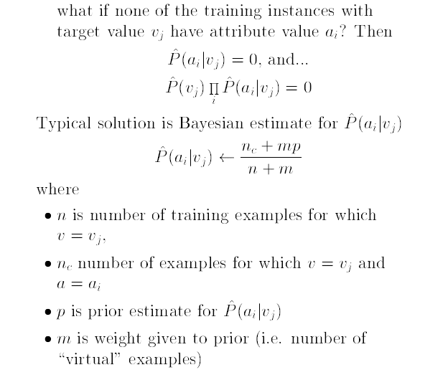
MACHINE INTELLIGENCE
Special Case

Slide 27
MACHINE INTELLIGENCE
Example2-Text Classification
sentence | class
A great game | sports
The election is over | Not sports
very clean match | sports
a clean but forgettable game | sports
it was a close election | not sports
consider the following data set
the task is to classify the sentence “A very close game”as sports or not sports
In this data set we do not have numbers but we have only text
We need to convert all this text into numbers that we can use for calculation. HOW?????
One solution is to use frequency of words
Ignore word order and sentence construction
Treat every document as a set of words it contains.
Now the feature used in this case is the counts of words i.e(words frequency)
Its a simplistic approach,but works surprisingly well

Slide 28
MACHINE INTELLIGENCE
Example2-Text Classification
sentence | class
A great game | sports
The election is over | Not sports
very clean match | sports
a clean but forgettable game | sports
it was a close election | not sports
Now,we need to transform the probability we want to calculate into something that can be calculated using word frequencies.
Bayes Theorem for example:
since in our classier ,we are just trying to find out which category has bigger probability we can discard the divisor
This is same for both the categories
we can compare
P(A very close game/sports) x P(sports)
with
P(A very close game/not sports) x P(not sports)

Slide 29
MACHINE INTELLIGENCE
Example2-Text Classification
sentence | class
A great game | sports
The election is over | Not sports
very clean match | sports
a clean but forgettable game | sports
it was a close election | not sports
The probabilities can be calculated:
count how many times the sentence
'A very close game' appears in sports category
Divide by the total
obtain P(a very close game|sports)
PROBLEM: we do not have the 'sentence' in the training set
=>probability is zero
unless every sentence appears in the training set,what we want to classify, the model wont classify

Slide 30
MACHINE INTELLIGENCE
Example2-Text Classification
sentence | class
A great game | sports
The election is over | Not sports
very clean match | sports
a clean but forgettable game | sports
it was a close election | not sports
so
we assume that every word in a sentence is independent of the other ones
no longer we will look for entire sentences,but for only words(individual)
i,e for a sentence “This was a funny party” is same as “funny is party was this” is same as “party funny this was a”
we can write this as:
P(a very close game)=P(a)xP(very)xP(close)xP(game)
This enables to make the model work well,
Now lets apply,
P(a very close game/sports)= P(a/sports)xP(very/sports)xP(close/sports)xP(game/sports) x P(sports)
Now as all these individual words actually show up several times in our training set,we can do our calculations

Slide 31
MACHINE INTELLIGENCE
Example2-Text Classification
sentence | class
A great game | sports
The election is over | Not sports
very clean match | sports
a clean but forgettable game | sports
it was a close election | not sports
CALCULATING PROBABILITIES
the final step is just to calculate every probability and see which one turns to be larger
First: calculate a priori probability for each category,i.e for the sentence given in the training set
P(sports)=3/5=0.6
P(not sports)=2/5=0.4
calculate P(game/sports) : counting number of times the word game appears in the sports sample,divided by the total no of words in sports
i.e it appears twice for 11 words. P(game/sports)=2/11=0.18181
A problem again
the word close does not appear in any sports ,and would lead us 0 when multiplied with other probability

Slide 32
MACHINE INTELLIGENCE
Example2-Text Classification
sentence | class
A great game | sports
The election is over | Not sports
very clean match | sports
a clean but forgettable game | sports
it was a close election | not sports
To resolve this we do something called Laplace smoothing
i.e we add 1 to every count so its never zero
to again balance this,we add the no of possible words to divisor,
in our case the possible words are:
{a,great,game,the election,is,over,.......election}=14
Applying smoothing we get
WORD | P(word/sports) | P(word/Not sports)
a | (2+1)/(14+11)=3/25 | (1+1)/(9+14)=2/23
very | (1+1)/(14+11)=2/25 | (0+1)/(9+14)=1/23
close | (0+1)/(14+11)=1/25 | (1+1)/(9+14)=2/23
game | (2+1)/(14+11)=3/25 | (0+1)/(9+14)=1/23

Slide 33
MACHINE INTELLIGENCE
Example2-Text Classification
WORD | P(word/sports) | P(word/Not sports)
a | (2+1)/(14+11)=3/25 | (1+1)/(9+14)=2/23
very | (1+1)/(14+11)=2/25 | (0+1)/(9+14)=1/23
close | (0+1)/(14+11)=1/25 | (1+1)/(9+14)=2/23
game | (2+1)/(14+11)=3/25 | (0+1)/(9+14)=1/23
sentence | class
A great game | sports
The election is over | Not sports
very clean match | sports
a clean but forgettable game | sports
it was a close election | not sports
Now we multiply all the probabilities to see which is bigger
P(a/sports)xP(very/sports)xP(close/sports)xP(game/sports)=0.000027648
P(a/not sports)xP(very/not sports)xP(close/not sports)xP(game/not sports)=5.717532x10⁻⁶
by this we successfully classify it as “sports category”

Slide 34
MACHINE INTELLIGENCE
Advanced Techniques
Removing stop words:
example: a,able,the
a very close game =>>>very close game
Words like election/elected are grouped together and counted as one word
Using n-grams:
instead of counting individual words we can count sequence of words
example:'clean match','close election'
TFIDF
term frequency–inverse document frequency, is a numerical statistic that is intended to reflect how important a word is to a document in a collection or corpus.

Slide 35
THANK YOU
K.S.Srinivas
srinivasks@pes.edu
+91 80 2672 1983 Extn 701

